Slide 1
GOOGLE ONLINE MARKETING CHALLENGE : Pre-Campaign Report

Slide 2
CLIENT OVERVIEW
Name : Taiga Inc.
Location : New York, based in Delaware
Number of employees : 11 – 50
URL : https://taiga.io/
Age of company : Founded on April 23,2014
Website Age : approx 2 years, launched in Oct 2014
Key online marketing personnel : Enrique Posner

Slide 3
CLIENT OVERVIEW
Goods & Services Offered : Project Management tool for agile based projects
Scrum & Kanban
Website (https://taiga.io/ ) managed by an in house IT team
Website hosted by Flossytems (servers in Netherlands)

Slide 4
CLIENT OVERVIEW
Google + presence : Yes but not very active
Company presence & sales : provided free.
From April 1, the user will be able to invest into 2 paid plans
Taigatribe :
Manage projects
Find talented people and engage in tasks

Slide 5
MARKET ANALYSIS
Current Customers :
Developers
Designers
Project Managers
Industry professionals
Potential Customers :
Individuals
Academic Institutions
Start-ups and medium sized organizations

Slide 6
MARKET ANALYSIS
Current Competitors
Rally
Zoho
AxoSoft
Trello
Potential Competitors
Any party that offers platform for developers & project managers

Slide 7
MARKET ANALYSIS
Industry : Project Portfolio Management
Industry Characteristics :
Fast growing; estimated to grow from $2.52b in 2015 $4.63b in 2020.
Highly competitive
PPM market expected to gain traction in the next 5 years to provide real time updates about projects to teams

Slide 8
MARKET ANALYSIS
Key Selling Point for Taiga :
Free, open source & powerful project management platform
Smooth & enjoyable experience to user
Ease of management
Taiga Tribe

Slide 9
MARKET ANALYSIS
Seasonal Characteristics in Website traffic :
20 % - 25 % drop in traffic/ new user registration during holiday season
Traffic generally drops 75 % - 80 % of a regular week average traffic during holiday season

Slide 10
MARKET ANALYSIS
Marketing Position/Specialties :
According to Accelerance.com –
‘Taiga is one of the best project management platforms for 2016’
9th in the list of right project management platforms to manage tasks’
Incentivize employees for finishing tasks through Taiga platform
Provides video conferencing to facilitate collaboration among teams

Slide 11
CURRENT MARKETING
Website Uses : 25 % on weekends as compared to weekdays
Total 102,253 projects
Approx. 232 new projects everyday
Total 119,170 users
Approx. 302 new users everyday
Total 498,934 User Stories
Approx. 2,121 User stories everyday
No marketing strategy used

Slide 12
CURRENT MARKETING
Website Strengths :
User friendly
Quick & Easy subscription process
Interactive
Customer-centric design
Useful & relevant content
Website Weakness :
Lack of mobile support
Support Page does not have any contact information

Slide 13
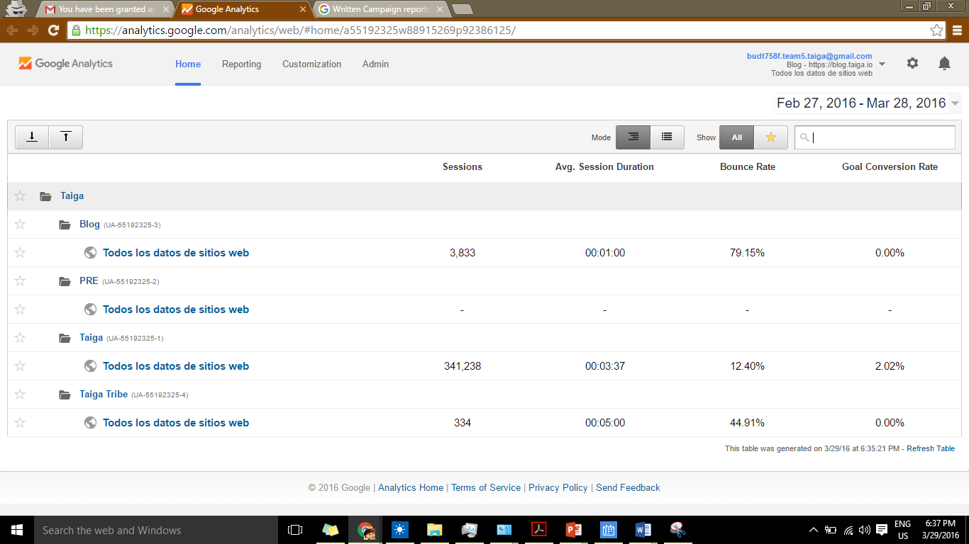
PRESENT GOOGLE ANALYTICS OVERVIEW

Slide 14
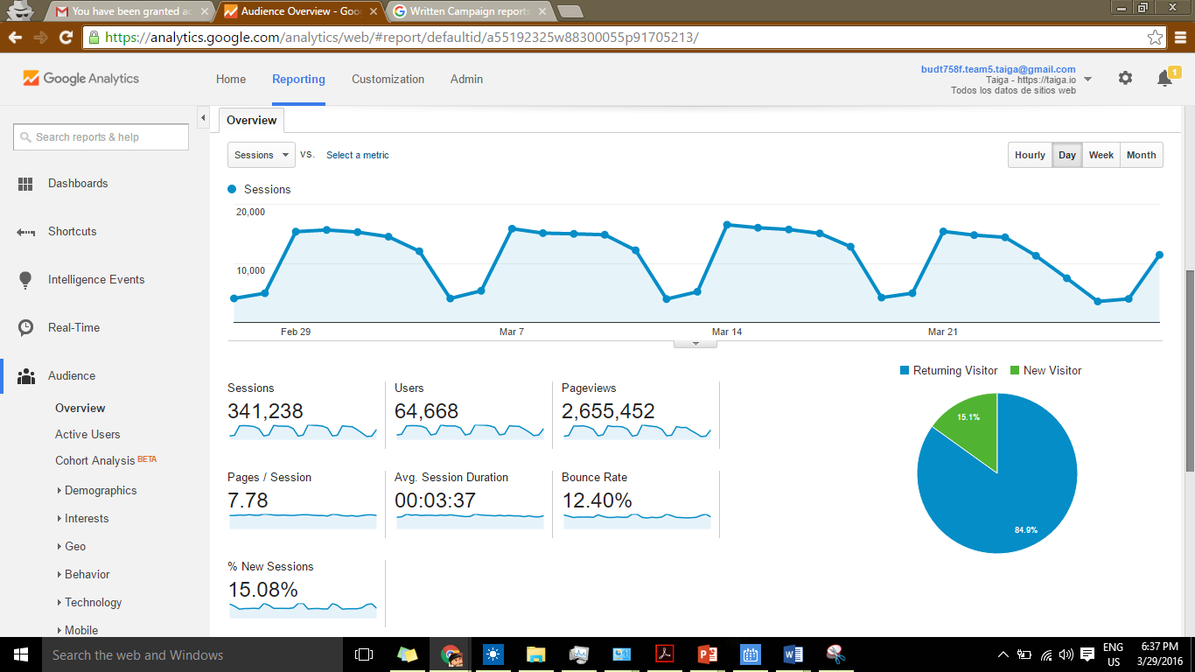
PRESENT GOOGLE ANALYTICS OVERVIEW

Slide 15
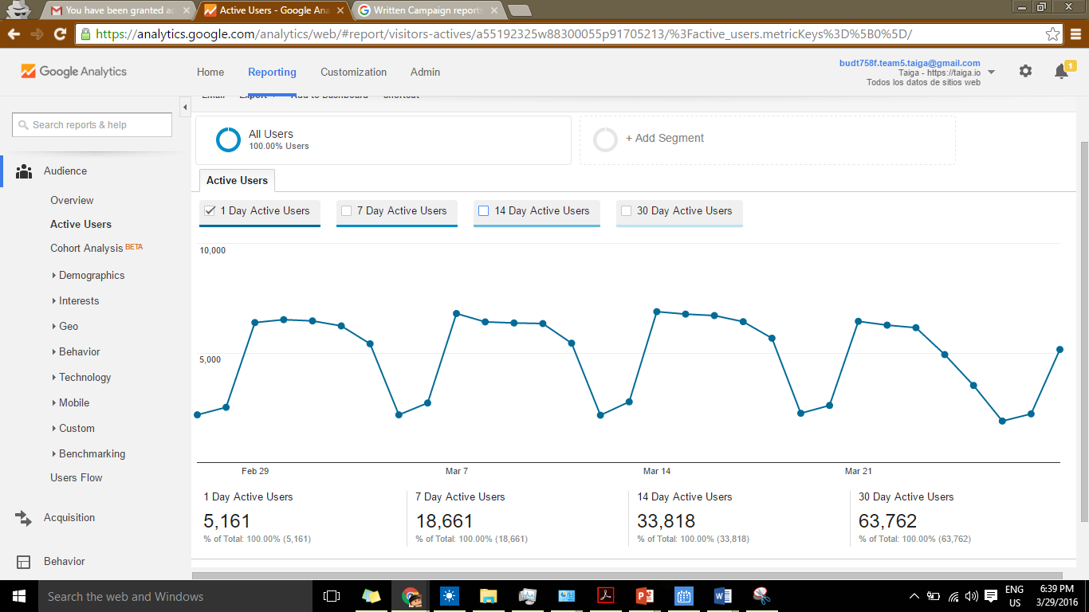
PRESENT GOOGLE ANALYTICS OVERVIEW

Slide 16
GOALS FOR GOMC
Increase visibility
Increase traffic on the website
Increase subscription rate
Increase User Acceptability of the tools
Promote TaigaTribe

